Slide 1


Slide 2

What is IMDb?
What are we doing with it?

Slide 3
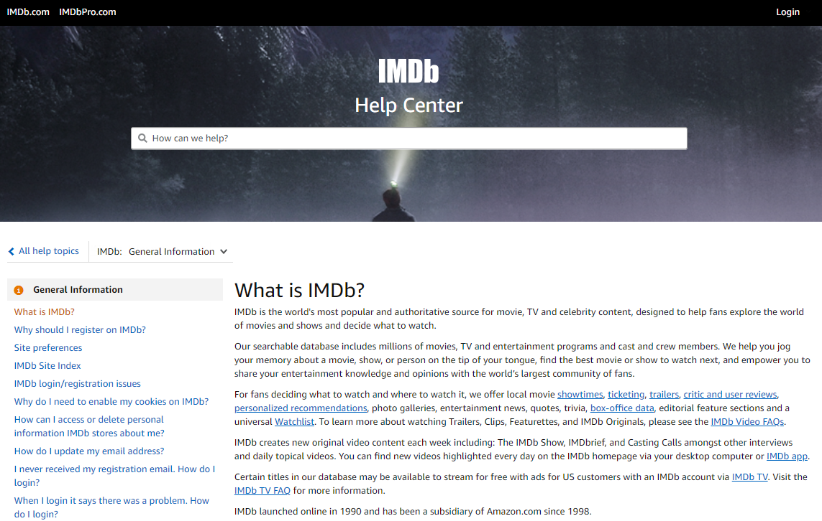
Source: https://help.imdb.com/article/imdb/general-information/what-is-imdb/G836CY29Z4SGNMK5?ref_=helpsect_cons_1_1#

Slide 4

Information of the base
Source: https://www.imdb.com/title/tt2584384/

Slide 5

Quick Glossary
So you know what are we talking about

Slide 6

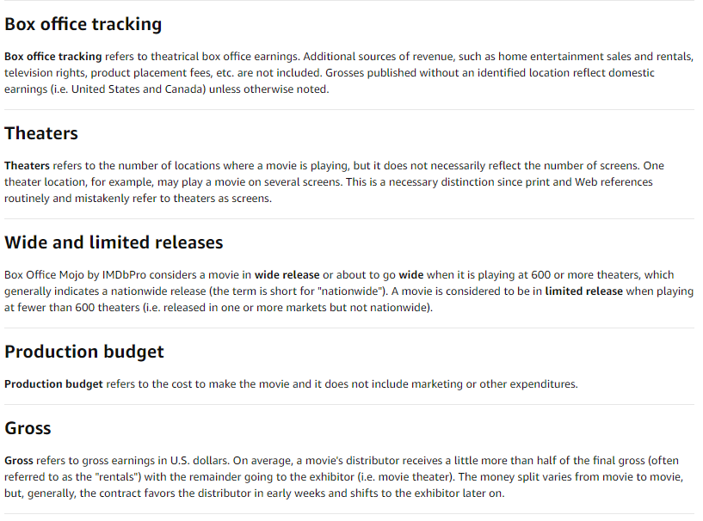
This is just for you to know where the gross comes from. They track the box office earnings and sum them to generate the gross income.
For the purpose of this analysis we are going to assume that the budget is the whole expense, we want to know it the movie made it or break it
For Gross Income, we considered all the data instead of just half, since we don’t know how much of that half is for the distributor and in simple numbers we wanted to know if the movie ‘made’ money or loss it.
Source: https://help.imdb.com/article/imdbpro/industry-research/box-office-by-imdbpro-glossary/GN8HA87MT4597FSW?ref_=helpart_nav_9#

Slide 7
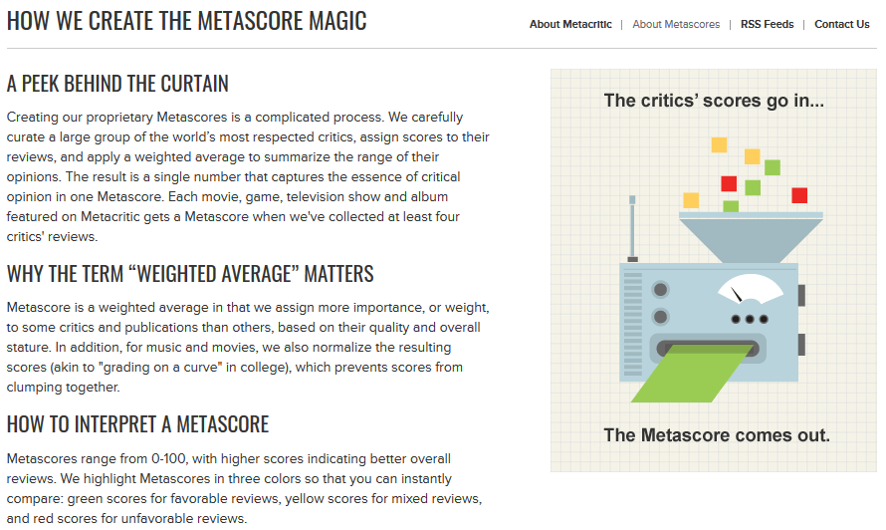
… in more simple words, the metascore is a normalize weighted average of the critics score (at least 4 critics to generate the metascore)
Source: https://www.metacritic.com/about-metascores

Slide 8

Question #1: Who are tougher with their ratings, the viewers or the critics?
The old debate will finally be decided

Slide 9

But first… what do we consider rating?
Viewer Ratings
“Weighted Average Vote” of all viewer ratings for a specific movie
Critic Ratings
Weighted score based on IMDb’s “Metascore” methodology

Slide 10
Ratings
User
Critics (Metascore in glossary)
IMDb registered users can cast a vote (range from 1 to 10).
Individual votes are aggregated and summarized as a single IMDb rating.
There is only one vote per title per user.
IMDB assigns more importance, to some critics and publications, based on quality and overall stature.
A movie gets a Metascore when at least four critics review that movie.
Range from 0-100.
IMDB normalizes the resulting scores (akin to "grading on a curve" in college), which prevents scores from clumping together.

Slide 11
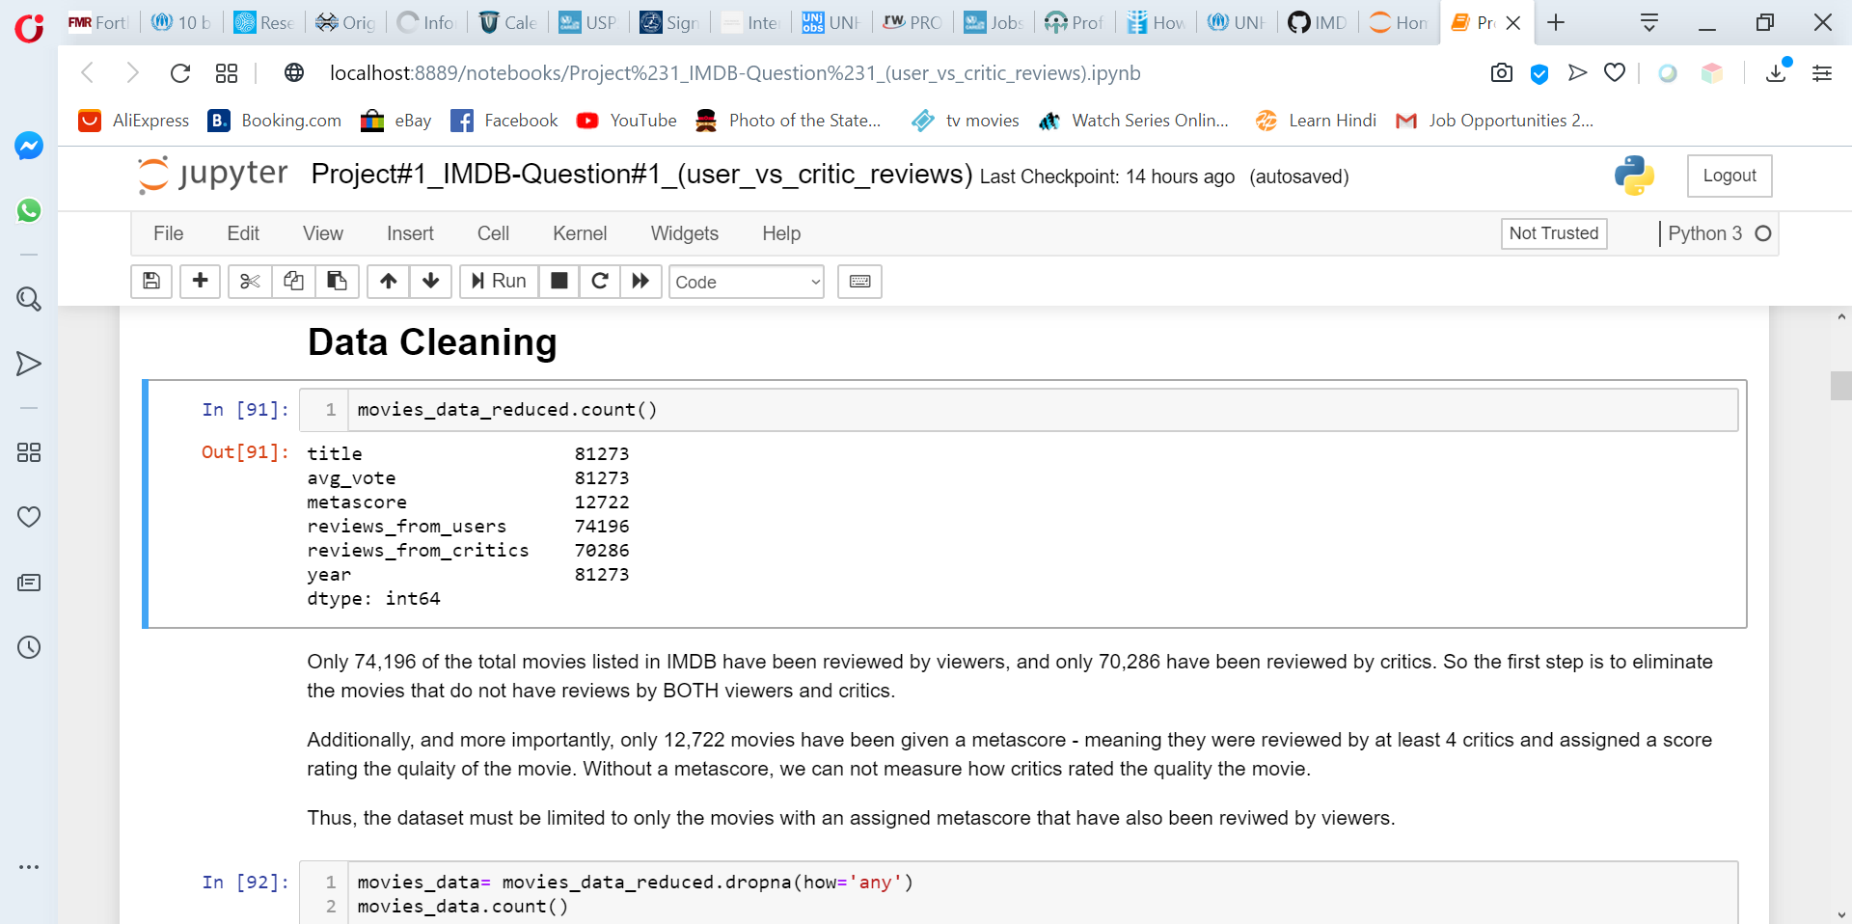
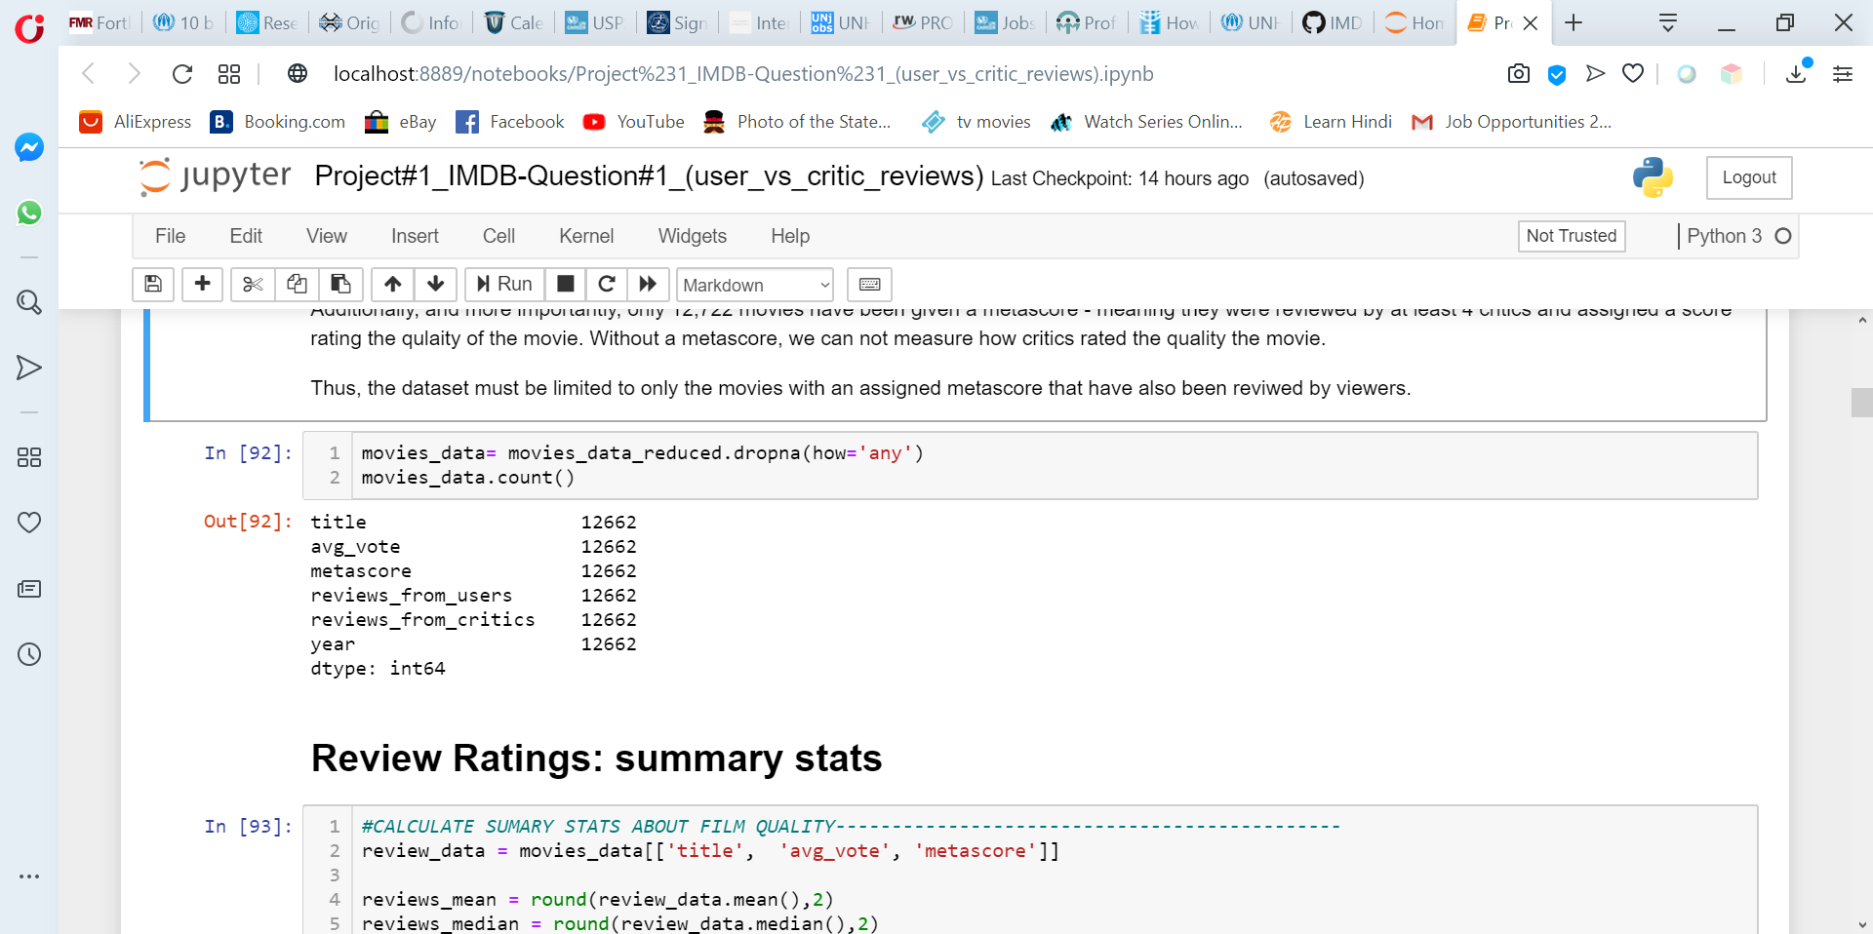
Data Cleaning
only 74,196 of the total movies listed in IMDB have been reviewed by viewers
only 70,286 have been reviewed by critics.
more importantly, only 12,722 movies have been given a metascore

Slide 12
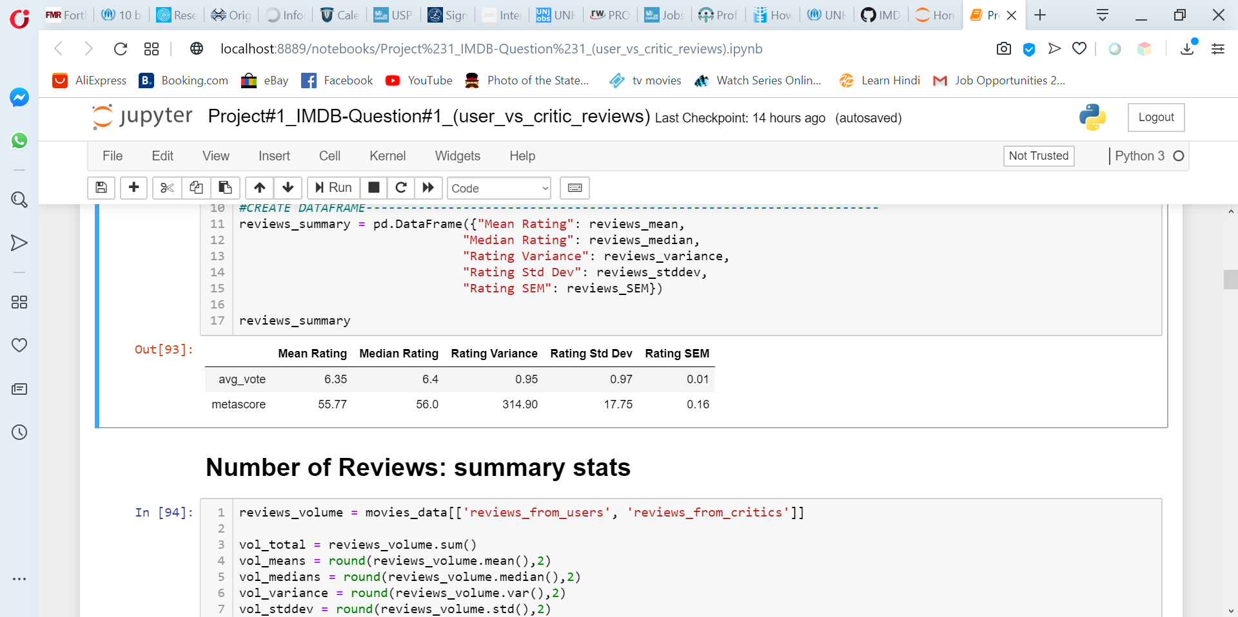
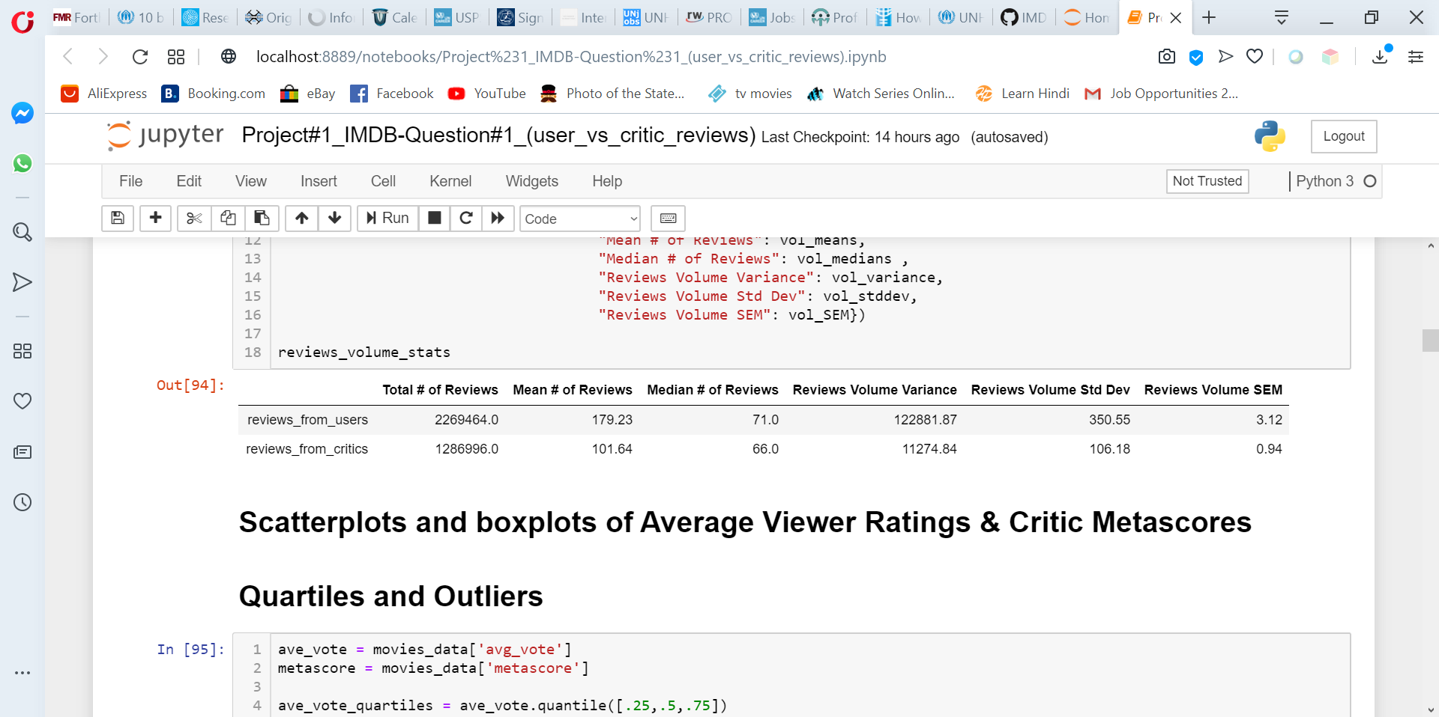
# of Reviews: Greater numbers of overall user reviews than critic reviews, but more consistency in the number of critic reviews of any given movie received vs. the number of user reviews each movie received.
Quality Ratings: more variability in the quality ratings given to movies by critics than by users → there was more consistency among what the viewers thought of the quality of the movie than what the critics thought.

Slide 13

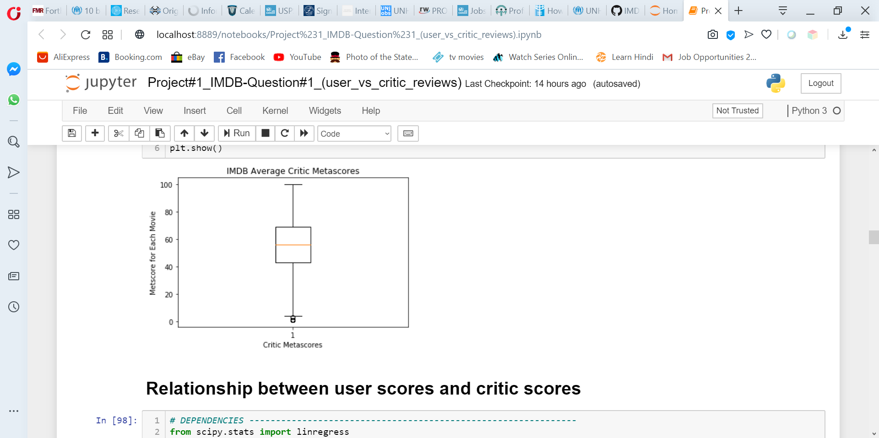
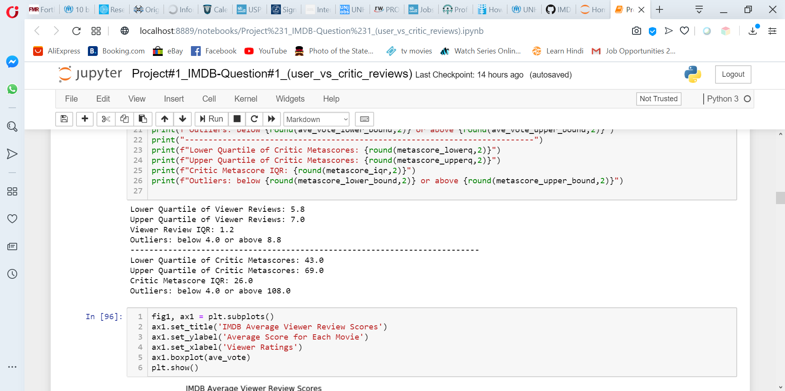
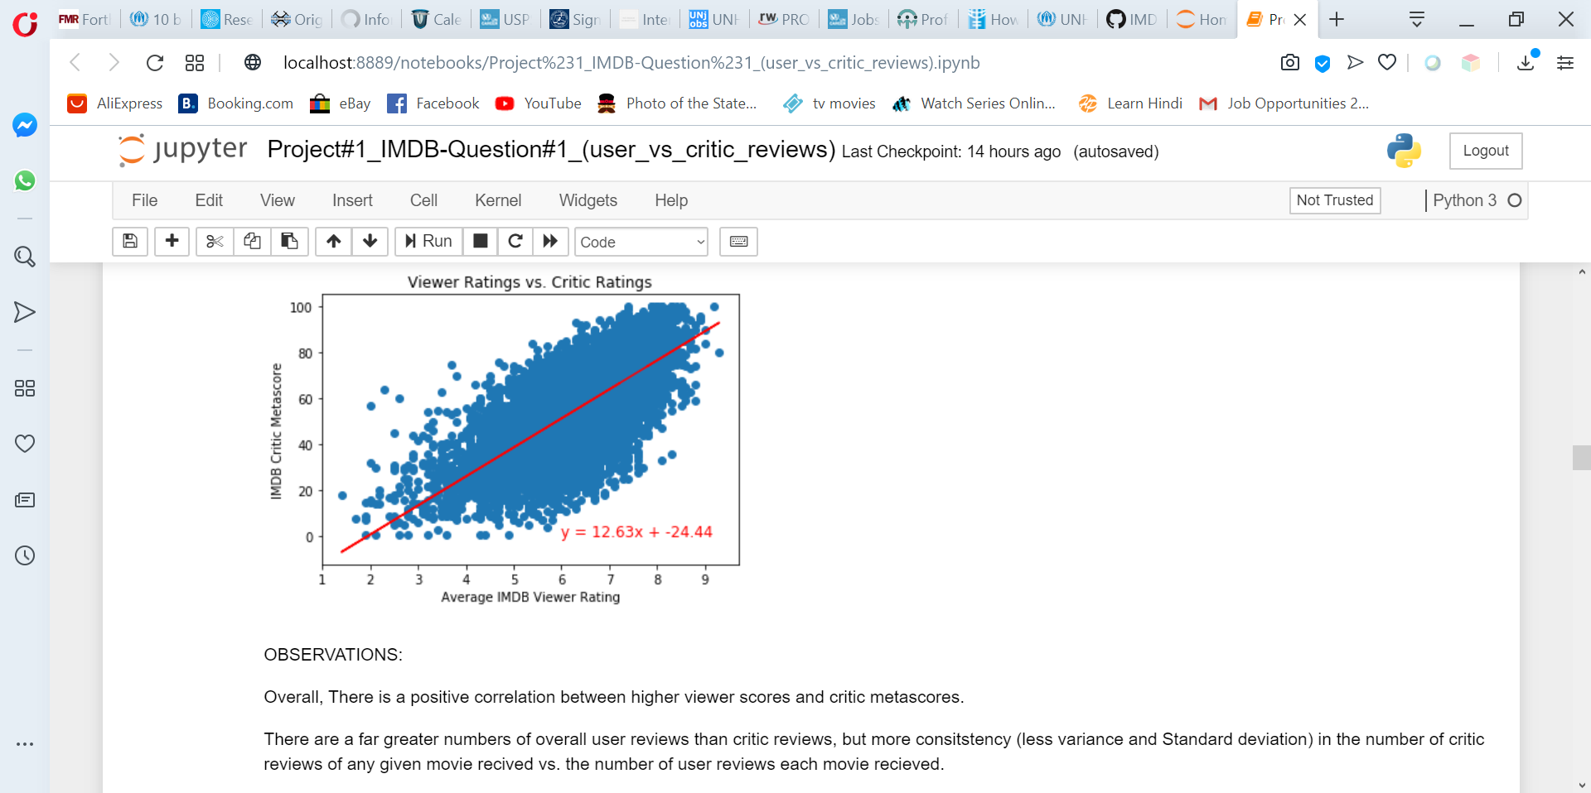

Slide 14
Viewers vs. Critics: Summary
Overall, there is a positive correlation between higher viewer scores and critic metascores.
With the metascore methodology applied by IMDB, critic metascores are already normalized (i.e. adjusted to a normal curve).
Viewer ratings are scaled from 1-10, metascores are scaled 1-100
Not be directly comparable without additional statistical analysis.
If we compare ave metascore relative to its range (1-100) to the ave voter score relative to its range (1-10), viewers do seem to rate movies overall slightly more favorably than critics.

Slide 15
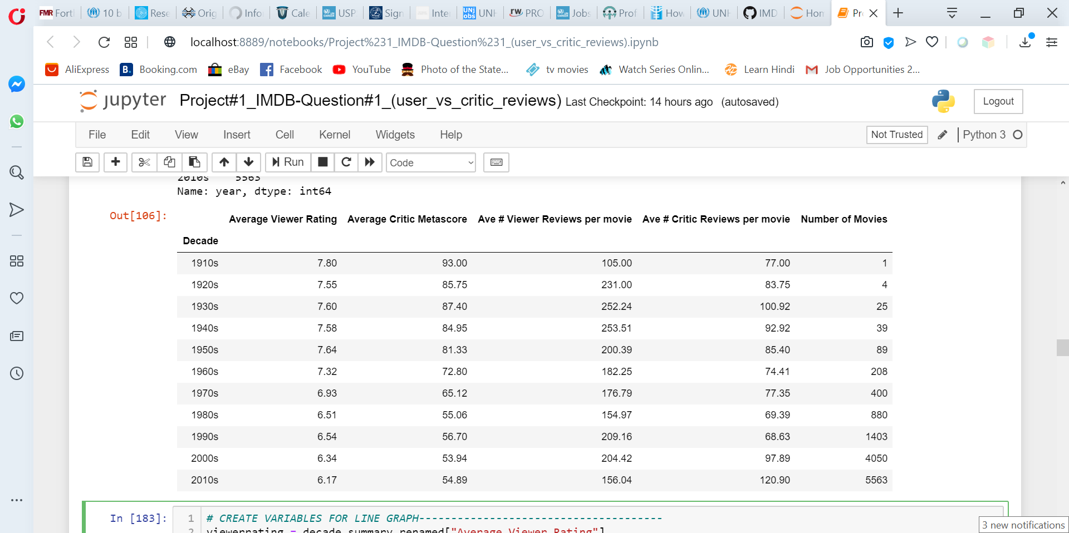
Viewer Ratings by film production year

Slide 16
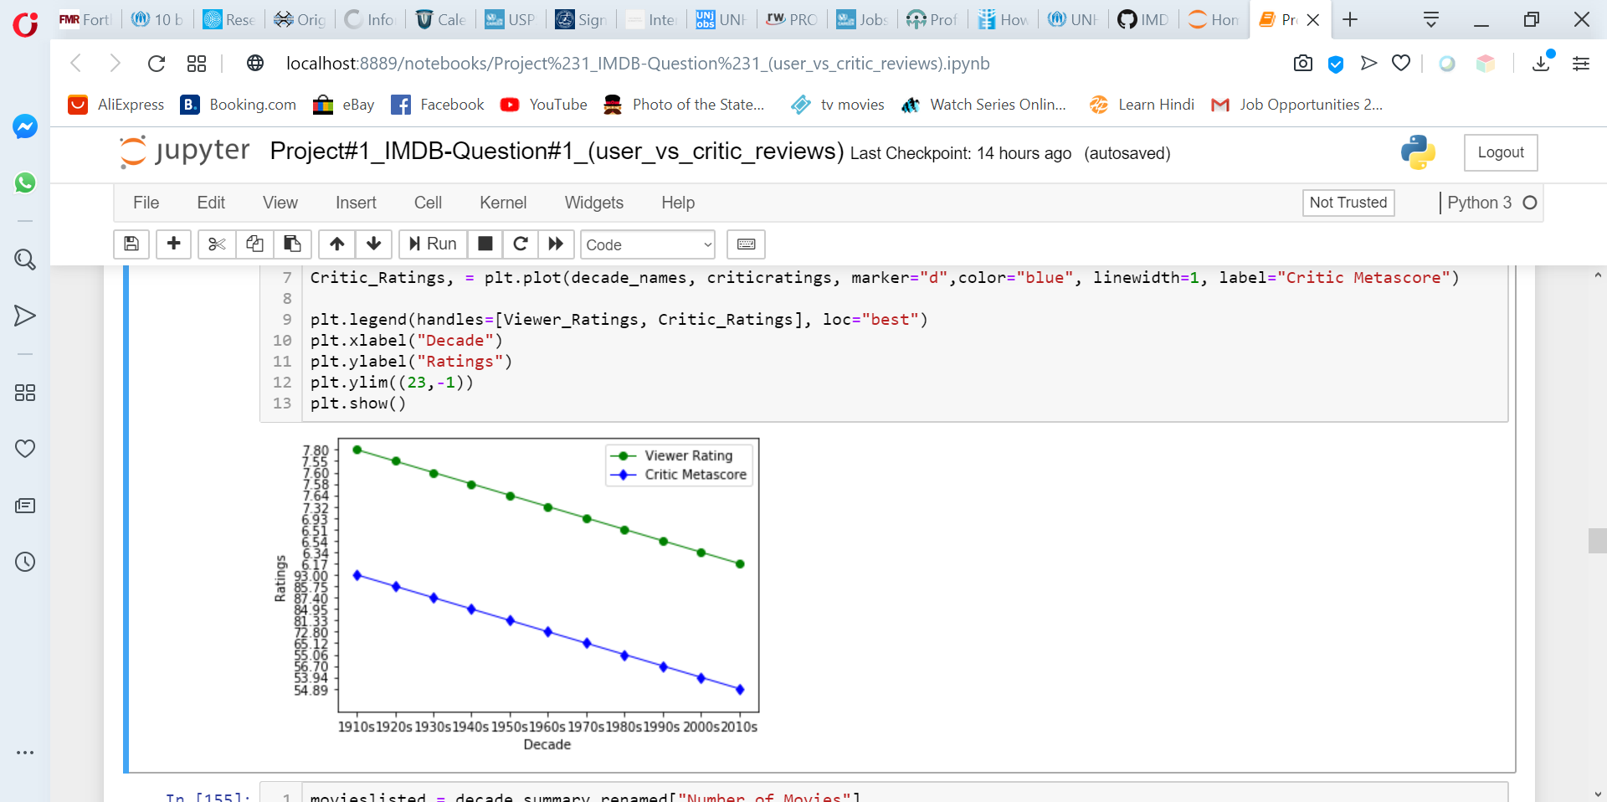
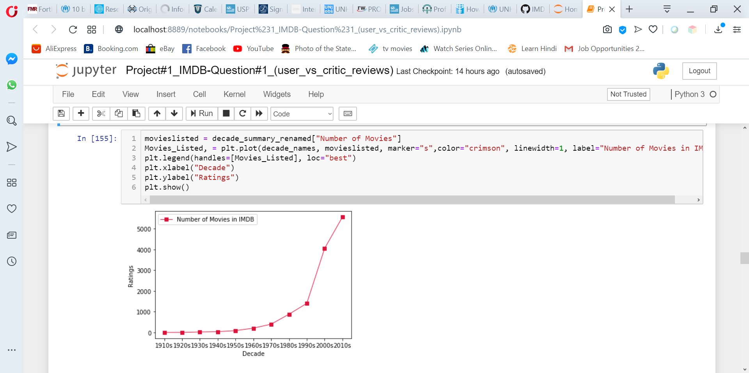
Both viewers and critics rated movies from 1960s and earlier higher.
Majority of the movies in IMDB were made in the 1970s and afterwards.
It could be that the better the quality of movies made before 1970, the more likely it is to be listed and reviewed on IMDB.

Slide 17
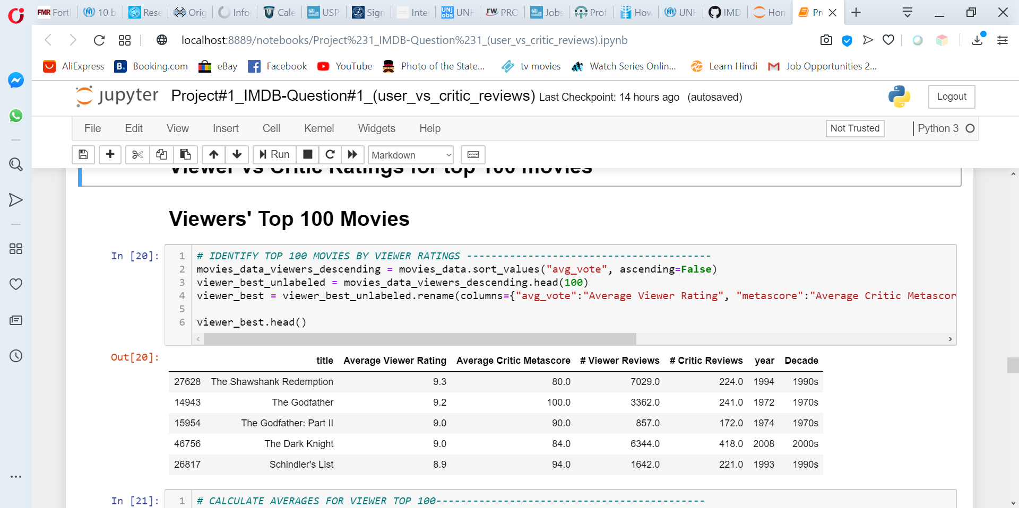
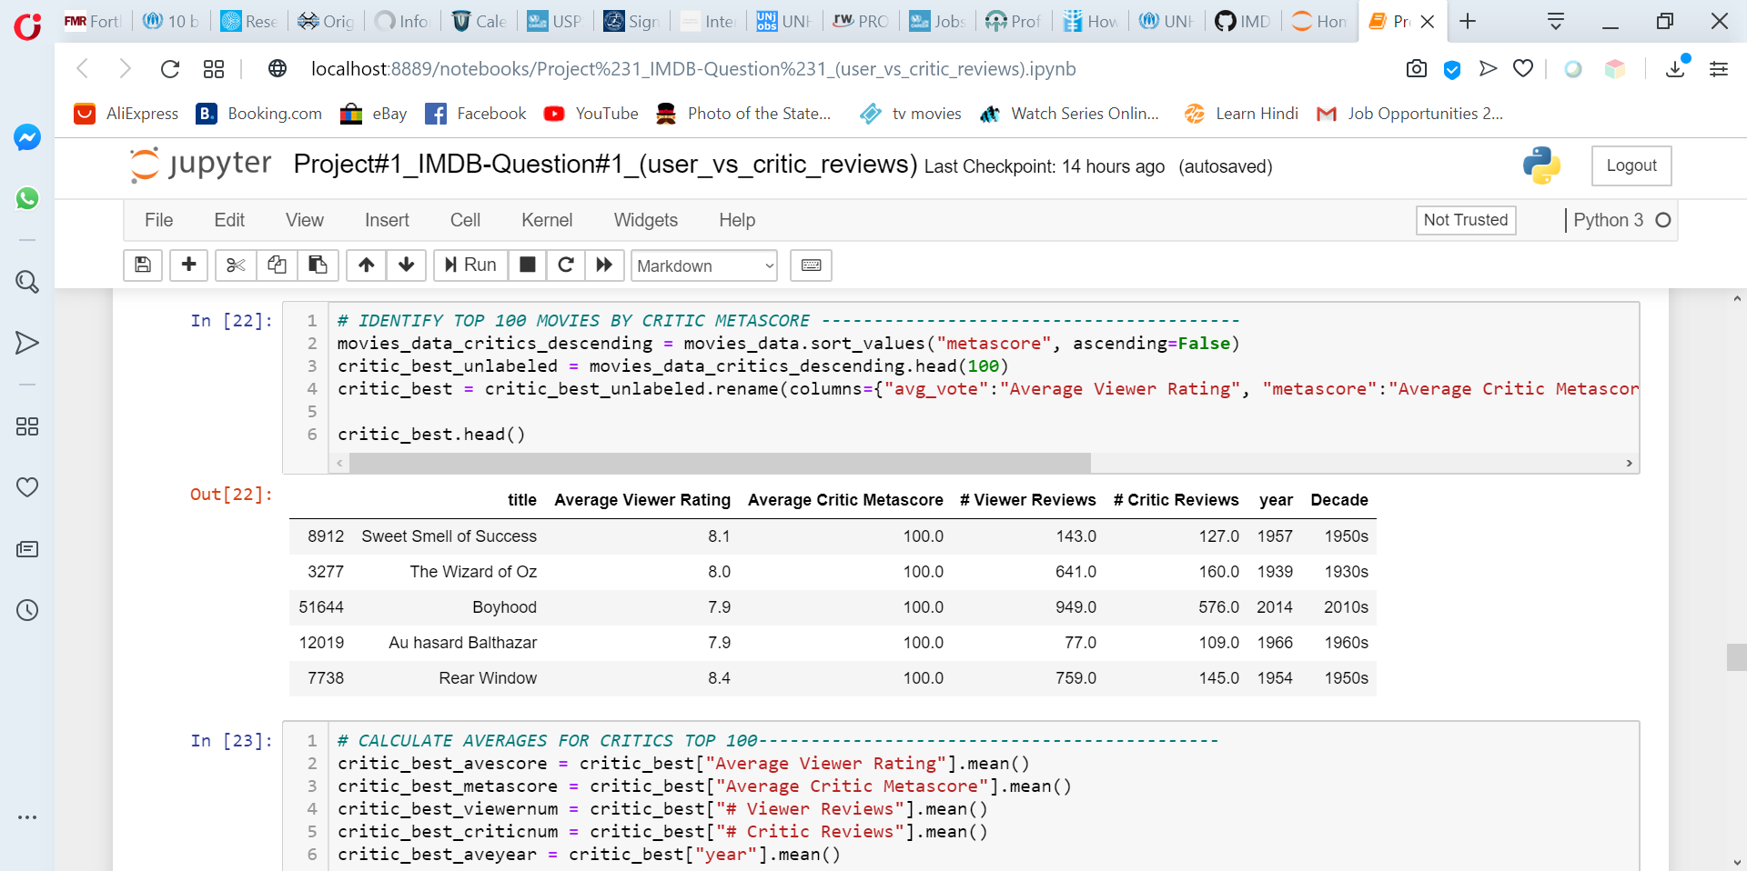
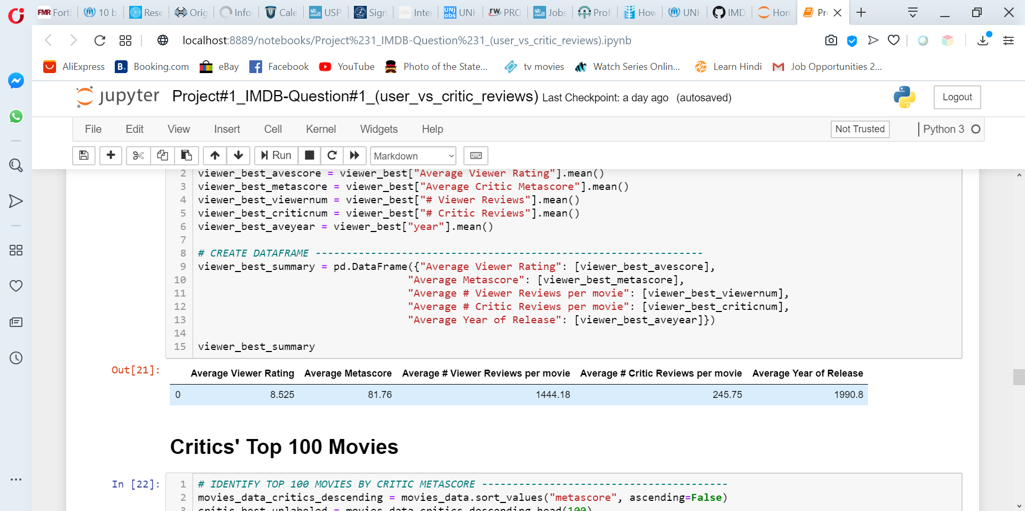
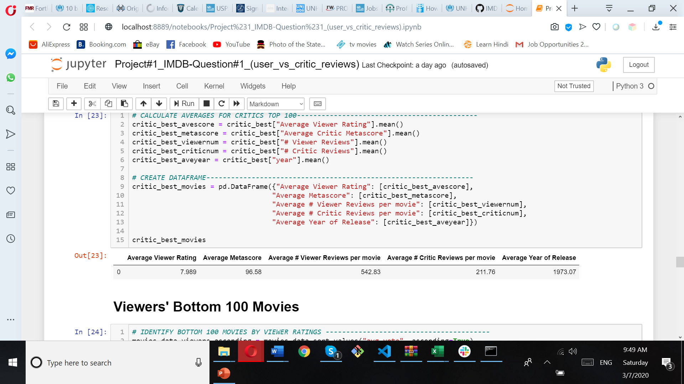
Top Movies
Viewers
Critics
VIEWERS
Viewers
Critics

Slide 18
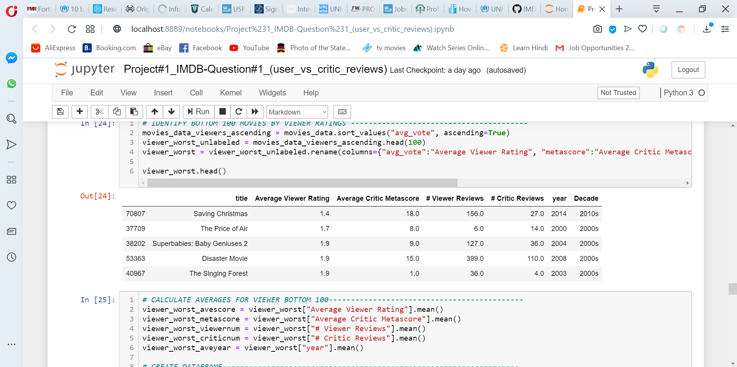
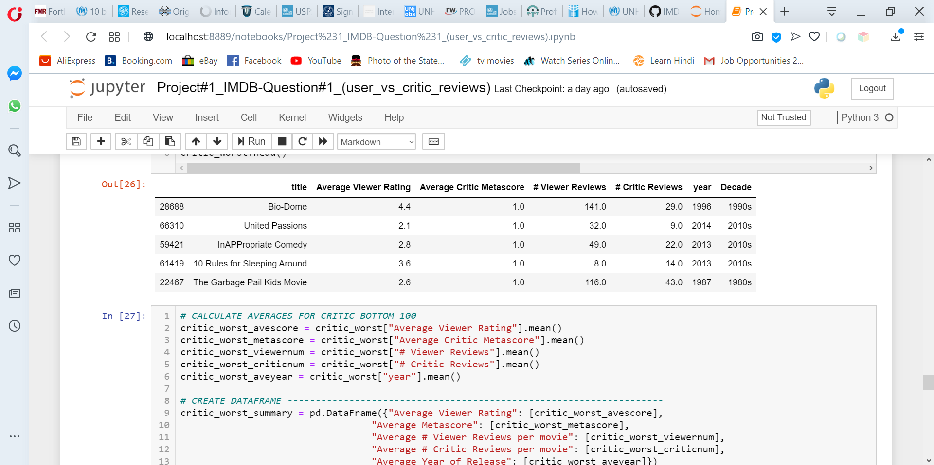
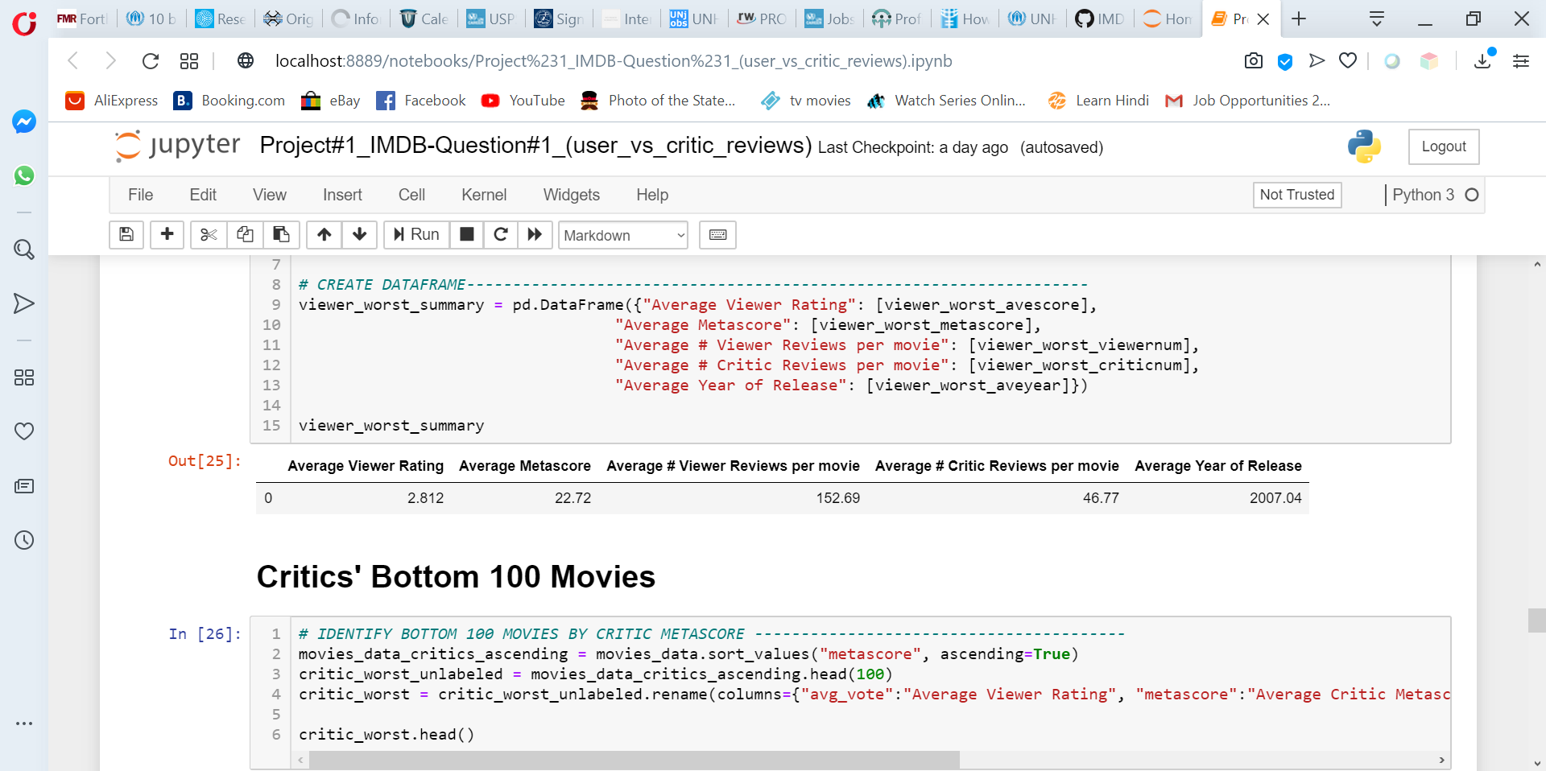
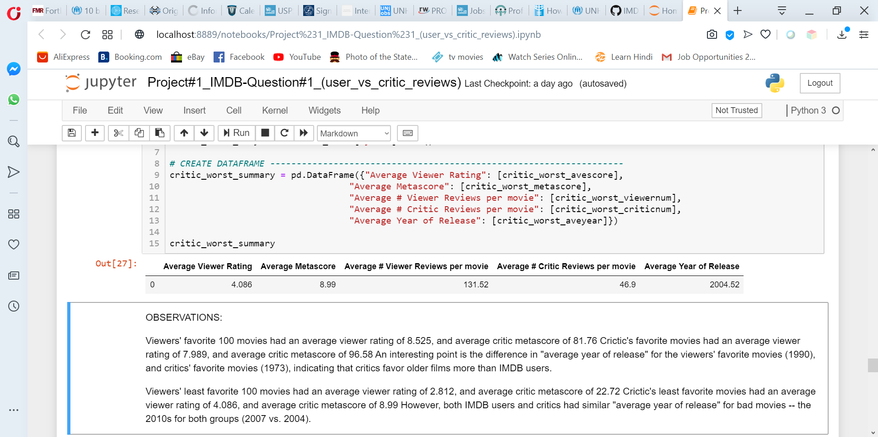
Worst Movies
Viewers
Critics
Viewers
Critics

Slide 19
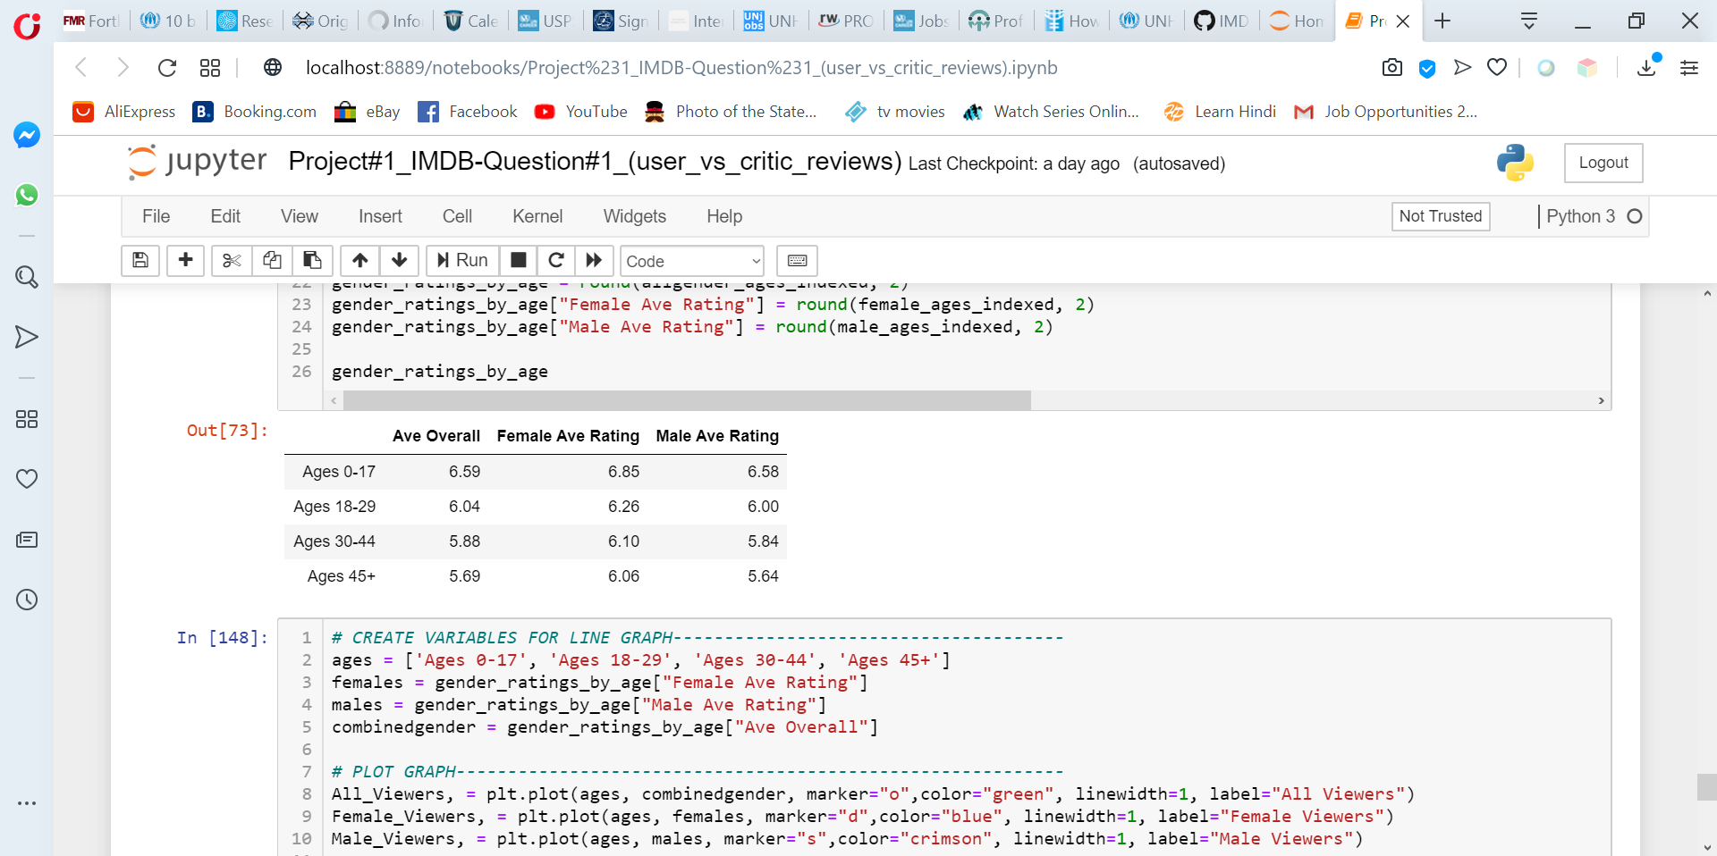
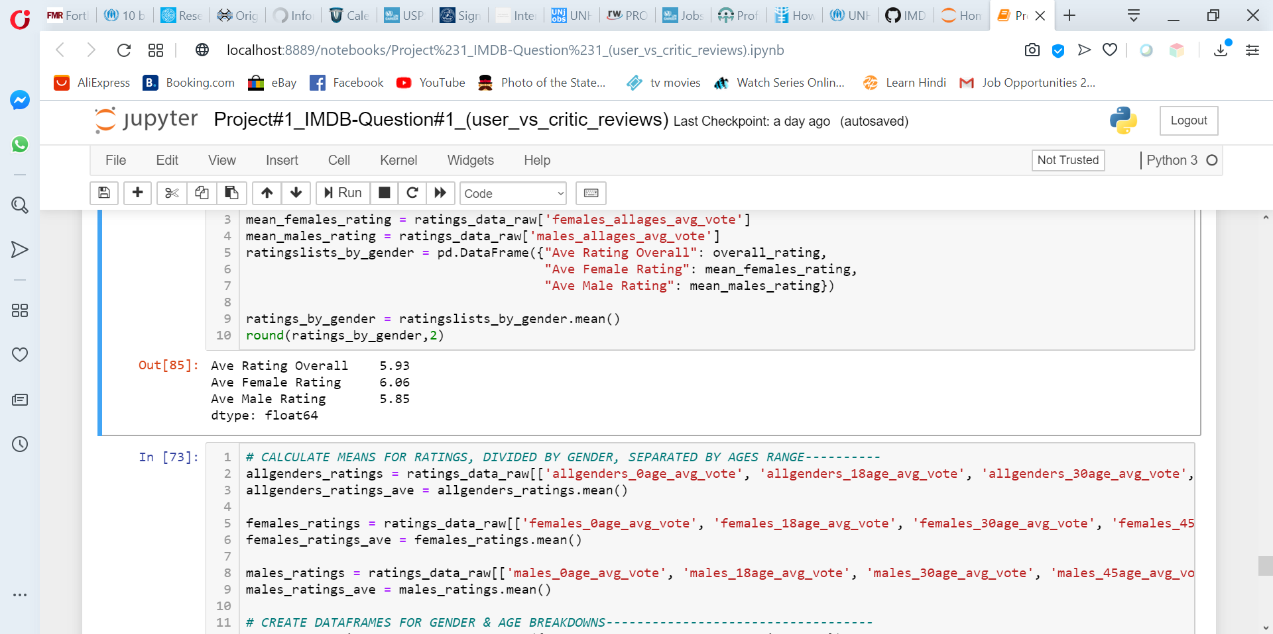
Viewers ratings by Gender

Slide 20
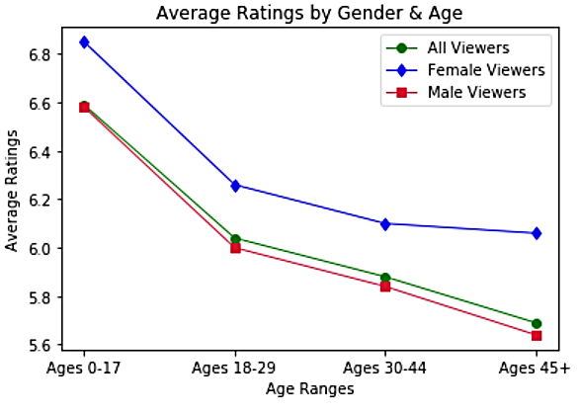

Slide 21
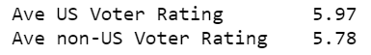
Viewers Ratings: US vs. Non-US
Females viewers rate movies slightly more favorably than male viewers. This trend is consistent across all age ranges when the data are divided by age.
Older viewers (both male and female) consistently give less favorable ratings than viewers younger than them.
Average ratings from US viewers trend slightly higher than for viewers in other countries.

Slide 22
Question #2: Is the success of a movie related to the director?
Let’s see directors with more than 1 movie

Slide 23
But first… what is success?
Revenue: We want to know if a movie made money or lose it.
US Gross income – budget
Worldwide Gross income – budget
Users ratings: We base it on user ratings considering that is the people who at the end of the day pays to see the movie.
US
Worldwide

Slide 24
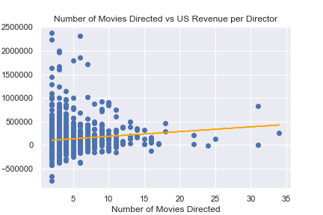
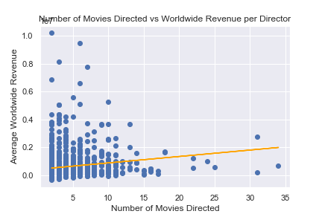
Number of movies vs Revenue
US
Worldwide
The correlation between the number of movies directed and the average revenue in US is 0.11
The correlation between the number of movies directed and the average revenue Worldwide is 0.15

Slide 25
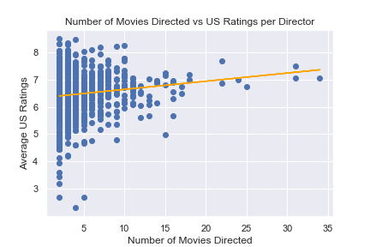
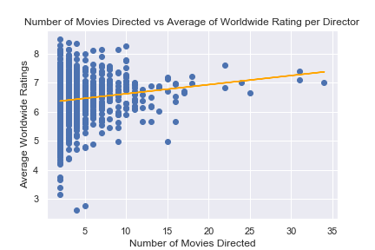
Number of movies vs Rating
US
Worldwide
The correlation between the number of movies directed and the average US Ratings is 0.13
The correlation between the number of movies directed and the average Worldwide Ratings is 0.14

Slide 26


Slide 27
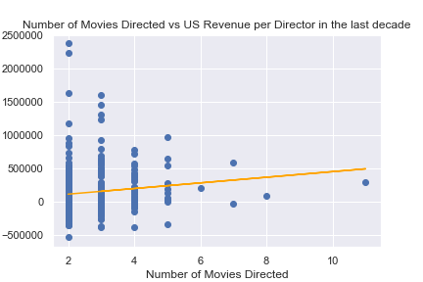
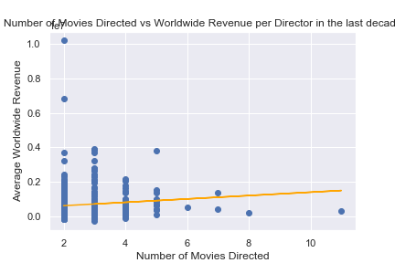
Number of movies vs Revenue in the last decade
US
Worldwide
The correlation between the number of movies directed and the average revenue in US is 0.13
The correlation between the number of movies directed and the average revenue Worldwide is 0.1

Slide 28
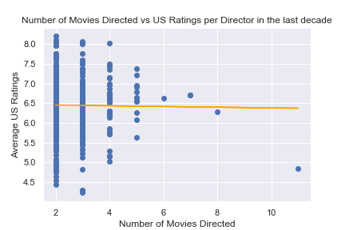
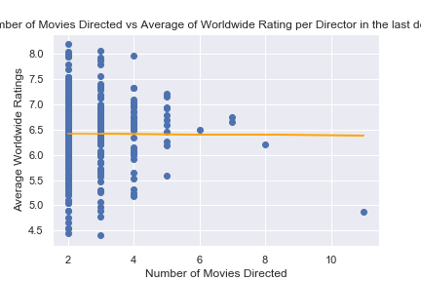
Number of movies vs Ratings in the last decade
US
Worldwide
The correlation between the number of movies directed and the average US Ratings is -0.01
The correlation between the number of movies directed and the average Worldwide Ratings is -0.01

Slide 29


Slide 30
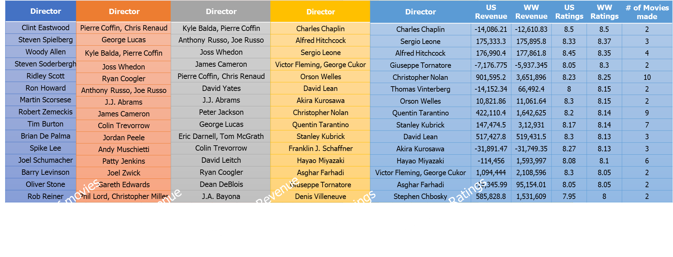
Quick recap
There is no correlation between the director and the success of a movie.
As an exercise we reviewed the top directors in movies directed, revenue us/worldwide and ratings us/worldwide.
None of them are the same

Slide 31
Top Directors per category
Director | US Revenue | WW Revenue | US Ratings | WW Ratings | # of Movies made
Clint Eastwood | 255,624.94 | 672,008.4 | 7.06 | 7.02 | 34
Steven Spielberg | 823,099.72 | 2,747,624 | 7.49 | 7.4 | 31
Woody Allen | 7,866.56 | 181,811.1 | 7.05 | 7.1 | 31
Steven Soderbergh | 124,813.94 | 595,427.8 | 6.75 | 6.64 | 25
Ridley Scott | -12,106.14 | 1,003,077 | 7 | 7 | 24
Ron Howard | 204,279.88 | 1,234,986 | 6.86 | 6.83 | 22
Martin Scorsese | 16,570.58 | 532,082.4 | 7.69 | 7.61 | 22
Robert Zemeckis | 456,780.23 | 1,681,409 | 7.19 | 7.2 | 18
Tim Burton | 282,990.65 | 1,635,640 | 6.98 | 6.97 | 18
Brian De Palma | 31,150.57 | 302,329.4 | 6.49 | 6.66 | 17
Spike Lee | 22,067.54 | 119,729.4 | 6.72 | 6.69 | 17
Joel Schumacher | 98,479.44 | 487,776.9 | 6.29 | 6.36 | 16
Barry Levinson | 159,735.88 | 458,340.1 | 6.54 | 6.54 | 16
Oliver Stone | 55,814.71 | 439,520.2 | 6.88 | 6.94 | 16
Rob Reiner | 136,117.20 | 338,235.4 | 6.95 | 6.98 | 16
Director | US Revenue | WW Revenue | US Ratings | WW Ratings | # of Movies made
Charles Chaplin | -14,086.21 | -12,610.83 | 8.5 | 8.5 | 2
Sergio Leone | 175,333.3 | 175,895.8 | 8.33 | 8.37 | 3
Alfred Hitchcock | 176,990.4 | 177,861.8 | 8.45 | 8.35 | 4
Giuseppe Tornatore | -7,176.775 | -5,937.345 | 8.05 | 8.3 | 2
Christopher Nolan | 901,595.2 | 3,651,896 | 8.23 | 8.25 | 10
Thomas Vinterberg | -14,152.34 | 66,492.4 | 8 | 8.15 | 2
Orson Welles | 10,821.86 | 11,061.64 | 8.3 | 8.15 | 2
Quentin Tarantino | 422,110.4 | 1,642,625 | 8.2 | 8.14 | 9
Stanley Kubrick | 147,474.5 | 3,12,931 | 8.17 | 8.14 | 7
David Lean | 517,427.8 | 519,431.5 | 8.3 | 8.13 | 3
Akira Kurosawa | -31,891.47 | -31,749.35 | 8.27 | 8.13 | 3
Hayao Miyazaki | -114,456 | 1,593,997 | 8.08 | 8.1 | 6
Victor Fleming, George Cukor | 1,094,444 | 2,108,596 | 8.3 | 8.05 | 2
Asghar Farhadi | -15,345.99 | 95,154.01 | 8.05 | 8.05 | 2
Stephen Chbosky | 585,828.8 | 1,531,609 | 7.95 | 8 | 2
Director | US Revenue | WW Revenue | US Ratings | WW Ratings | # of Movies made
Kyle Balda, Pierre Coffin | 2,233,350 | 10,200,990 | 6.25 | 6.35 | 2
Anthony Russo, Joe Russo | 1,863,340 | 9,475,804 | 7.53 | 7.42 | 6
Joss Whedon | 1,996,261 | 8,171,628 | 7.97 | 7.7 | 3
James Cameron | 1,715,897 | 7,754,444 | 7.94 | 7.9 | 7
Pierre Coffin, Chris Renaud | 2,372,897 | 6,844,400 | 7.45 | 7.45 | 2
David Yates | 685,507.8 | 6,590,555 | 7.28 | 7.22 | 6
J.J. Abrams | 1,798,410 | 5,588,431 | 7.7 | 7.48 | 5
Peter Jackson | 890,628.3 | 5,284,648 | 7.76 | 7.79 | 10
George Lucas | 2,313,956 | 5,106,583 | 7.22 | 7.22 | 6
Eric Darnell, Tom McGrath | 733,326.5 | 5,076,285 | 6.63 | 6.77 | 3
Colin Trevorrow | 1,666,789 | 5,062,240 | 6.87 | 6.87 | 3
David Leitch | 700,299 | 4,346,929 | 7.07 | 6.97 | 3
Ryan Coogler | 1,966,762 | 4,339,889 | 7.7 | 7.47 | 3
Dean DeBlois | 319,012.1 | 4,337,171 | 7.7 | 7.65 | 2
J.A. Bayona | 608,268.2 | 4,319,548 | 7.1 | 7.1 | 3
Director | US Revenue | WW Revenue | US Ratings | WW Ratings | # of Movies made
Pierre Coffin, Chris Renaud | 2,372,897 | 6,844,400 | 7.45 | 7.45 | 2
George Lucas | 2,313,956 | 5,106,583 | 7.22 | 7.22 | 6
Kyle Balda, Pierre Coffin | 2,233,350 | 1,0200,990 | 6.25 | 6.35 | 2
Joss Whedon | 1,996,261 | 8,171,628 | 7.97 | 7.7 | 3
Ryan Coogler | 1,966,762 | 4,339,889 | 7.7 | 7.46 | 3
Anthony Russo, Joe Russo | 1,863,340 | 9,475,804 | 7.53 | 7.42 | 6
J.J. Abrams | 1,798,410 | 5,588,431 | 7.7 | 7.48 | 5
James Cameron | 1,715,897 | 7,754,444 | 7.94 | 7.9 | 7
Colin Trevorrow | 1,666,789 | 5,062,240 | 6.87 | 6.87 | 3
Jordan Peele | 1,632,733 | 2,430,098 | 7.5 | 7.3 | 2
Andy Muschietti | 1,605,123 | 3,937,348 | 6.87 | 6.77 | 3
Patty Jenkins | 1,450,163 | 3,616,581 | 7.55 | 7.35 | 2
Joel Zwick | 1,292,773 | 1,931,477 | 5.55 | 5.4 | 2
Gareth Edwards | 1,241,969 | 4,082,588 | 7.03 | 6.87 | 3
Phil Lord, Christopher Miller | 1,151,995 | 2,479,965 | 7.38 | 7.23 | 4
Director | US Revenue | WW Revenue | US Ratings | WW Ratings | # of Movies made
Charles Chaplin | -14,086.21 | -12,610.83 | 8.50 | 8.5 | 2
Alfred Hitchcock | 176,990.4 | 177,861.8 | 8.45 | 8.35 | 4
Sergio Leone | 175,333.3 | 175,895.8 | 8.33 | 8.37 | 3
Victor Fleming, George Cukor | 1,094,444 | 2,108,596 | 8.30 | 8.05 | 2
Orson Welles | 10,821.86 | 11,061.64 | 8.30 | 8.15 | 2
David Lean | 517,427.8 | 519,431.5 | 8.30 | 8.13 | 3
Akira Kurosawa | -31,891.47 | -31,749.35 | 8.27 | 8.13 | 3
Christopher Nolan | 901,595.2 | 3,651,896 | 8.23 | 8.25 | 10
Quentin Tarantino | 422,110.4 | 1,642,625 | 8.2 | 8.14 | 9
Stanley Kubrick | 147,474.5 | 312,931 | 8.17 | 8.14 | 7
Franklin J. Schaffner | 392,688.0 | 392,709.2 | 8.1 | 7.97 | 3
Hayao Miyazaki | -114,456.0 | 1,593,997 | 8.08 | 8.1 | 6
Asghar Farhadi | -15,345.99 | 95,154.01 | 8.05 | 8.05 | 2
Giuseppe Tornatore | -7,176.775 | -5,937.345 | 8.05 | 8.3 | 2
Denis Villeneuve | 45,526.45 | 789,297.1 | 8.04 | 7.98 | 5
Number of movies
US Revenue
Worldwide Revenue
US Ratings
Worldwide Ratings

Slide 32
Question #3: Is the success of a movie related to the director’s budget?
Let’s think in terms of money

Slide 33

General considerations of the initial data
# Directors | 2,542
# of Movies | 5,400
Max # Movies per Director | 33
Years | 1931 to 2019
Budget | From $0.2k to $880,000k
Deleted outliers from budget (upper)
Only information stored in US Dollars and displayed in USD
Information presented in thousands of dollars, to minimize 0’s

Slide 34
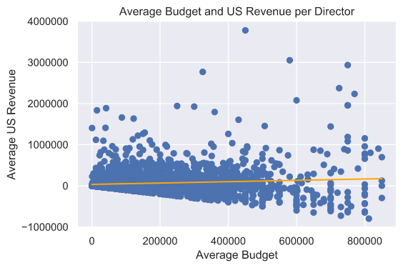
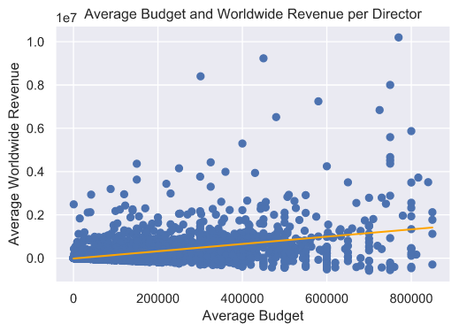
Budget vs Revenue
US
Worldwide
The correlation between the average budget and the average revenue in US is 0.1
The correlation between the average budget and the average revenue Worldwide is 0.4

Slide 35
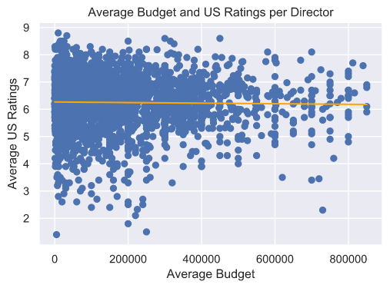
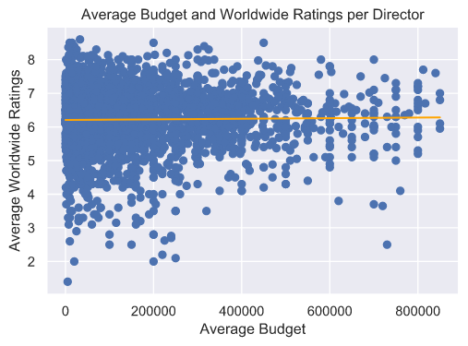
Budget vs Ratings
US
Worldwide
The correlation between the average budget and the average ratings in US is -0.02
The correlation between the average budget and the average ratings Worldwide is 0.02

Slide 36

Results
There is a mild correlation between the Budget and the Worldwide Revenue
The rest of the information doesn’t make that much of a sense
So far, there is no correlation between the budget and ratings per director’s budget.
What if…?

Slide 37
General considerations of last decade
# Directors | 1,188
# of Movies | 1,752
Max # Movies per Director | 11
Years | 2009 to 2019
Budget | From $120k to $1,120,000k
Deleted outliers from budget in new data (upper)
USD and thousands of dollars

Slide 38
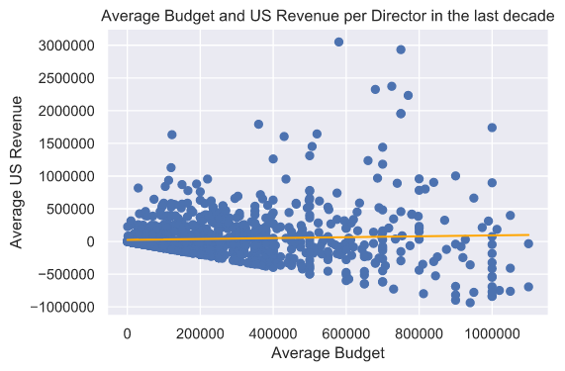
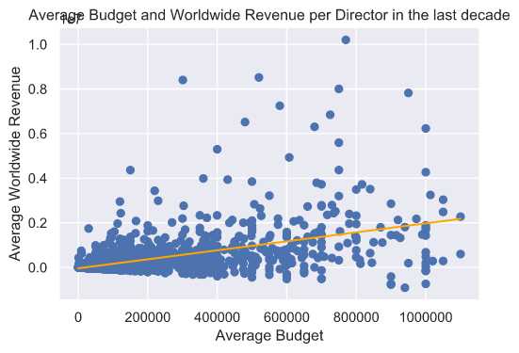
Budget vs Revenue in the last decade
US
Worldwide
The correlation between the average budget and the average revenue in US in the last decade is 0.05
The correlation between the average budget and the average revenue Worldwide in the last decade is 0.48

Slide 39
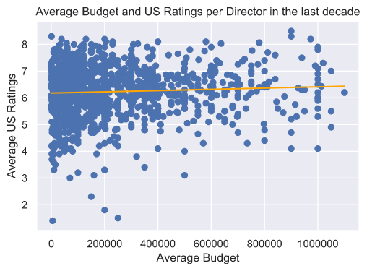
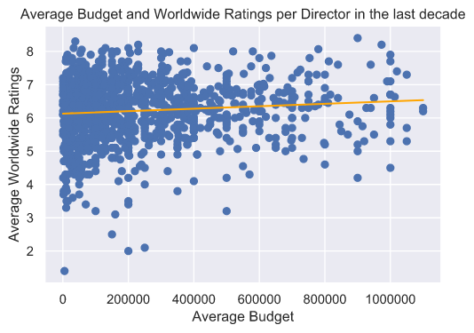
Budget vs Ratings in the last decade
US
Worldwide
The correlation between the average budget and the average ratings in US in the last decade is 0.06
The correlation between the average budget and the average ratings Worldwide in the last decade is 0.1

Slide 40

Results
There is no much of a difference.
We still see a mild correlation between the revenue Worldwide and the budget, but again, doesn’t seem that significant.
What if…?

Slide 41
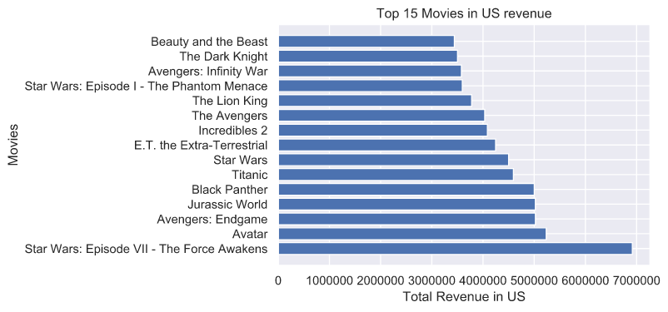
Top 15 movies with biggest revenue in US

Slide 42
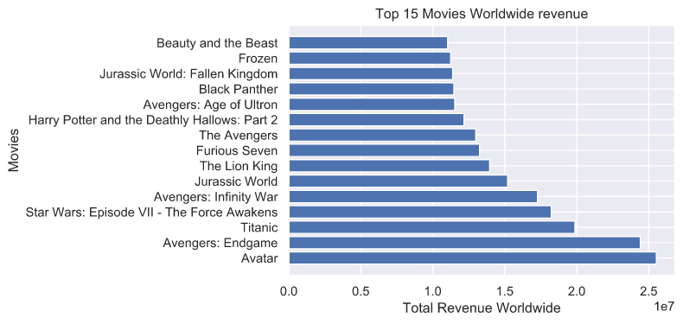
Top 15 movies with biggest revenue Worldwide

Slide 43
Top movies summary
Title | Year | Director | US Revenue | WW Revenue | Top US | Top WW
The Lion King | 2019 | Jon Favreau | 2,834,968 | 13,951,569 | 11 | 7
Avengers: Endgame | 2019 | Anthony Russo, Joe Russo | 5,023,730 | 24,418,006 | 3 | 2
Incredibles 2 | 2018 | Brad Bird | 4,085,817 | 10,428,054 | 9 | -
Jurassic World: Fallen Kingdom | 2018 | J.A. Bayona | 2,477,198 | 11,384,679 | - | 13
Avengers: Infinity War | 2018 | Anthony Russo, Joe Russo | 3,578,155 | 17,273,598 | 13 | 5
Black Panther | 2018 | Ryan Coogler | 5,000,596 | 11,469,132 | 5 | 12
Beauty and the Beast | 2017 | Bill Condon | 3,440,142 | 11,035,211 | 15 | 15
Star Wars: Episode VII - The Force Awakens | 2015 | J.J. Abrams | 6,916,622 | 18,232,236 | 1 | 4
Jurassic World | 2015 | Colin Trevorrow | 5,022,706 | 15,204,006 | 4 | 6
Avengers: Age of Ultron | 2015 | Joss Whedon | 2,090,059 | 11,528,059 | - | 11
Furious Seven | 2015 | James Wan | 1,630,070 | 13,250,477 | - | 8
Frozen | 2013 | Chris Buck, Jennifer Lee | 2,507,380 | 11,242,190 | - | 14
The Avengers | 2012 | Joss Whedon | 4,033,579 | 12,988,130 | 10 | 9
Harry Potter and the Deathly Hallows: Part 2 | 2011 | David Yates | 2,564,093 | 12,169,324 | - | 10
Avatar | 2009 | James Cameron | 5,235,076 | 25,529,683 | 2 | 1
The Dark Knight | 2008 | Christopher Nolan | 3,502,340 | 8,199,340 | 14 | -
Star Wars: Episode I - The Phantom Menace | 1999 | George Lucas | 3,595,447 | 9,120,827 | 12 | -
Titanic | 1997 | James Cameron | 4,593,639 | 19,874,639 | 6 | 3
The Lion King | 1994 | Roger Allers, Rob Minkoff | 3,777,838 | 9,235,118
E.T. the Extra-Terrestrial | 1982 | Steven Spielberg | 4,246,106 | 7,824,106 | 8 | -
Star Wars | 1977 | George Lucas | 4,499,985 | 7,645,121 | 7 | -

Slide 44

Conclusion
Overall, critics are slight tougher reviewers, but it depends on the movie. Critics and viewers like different types of movies.
Men and non-US viewers are typically harsher critics.
There is not relation between the director and the success of a movie
There is a small relationship between the budget a director has and the worldwide revenue of a movie.

